Slide 1
Arduino - Controllers

Slide 2
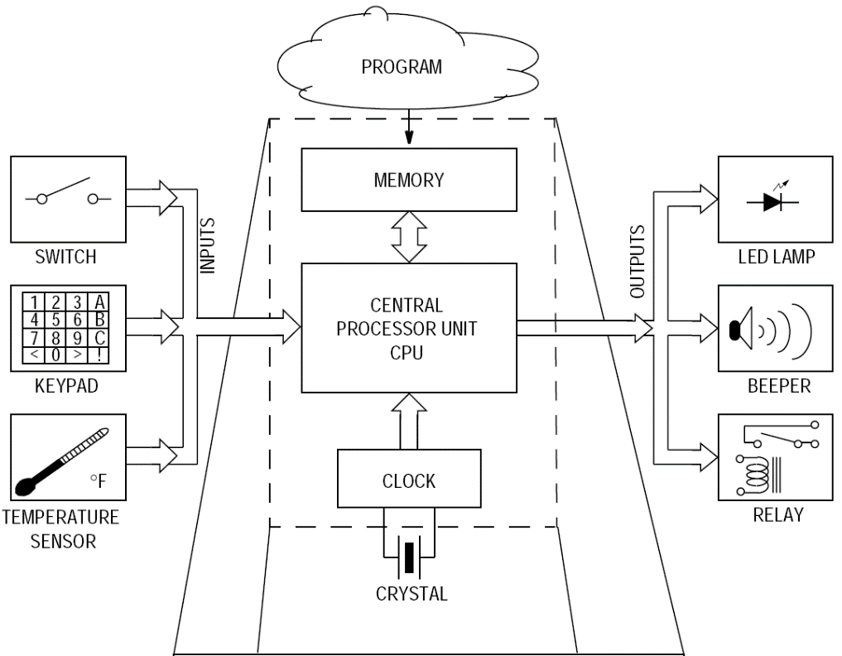

Slide 3
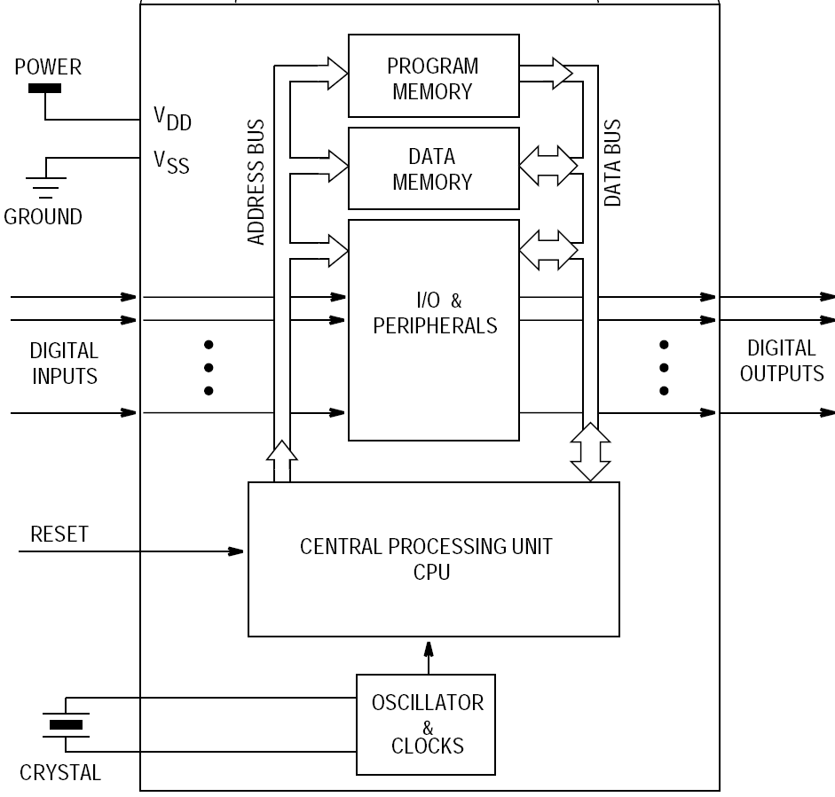
ANALOG
INPUTS

Slide 4
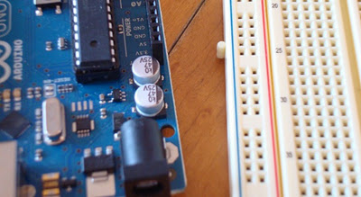
What is a Development Board
A printed circuit board designed to facilitate work with a particular microcontroller.
Typical components include:
  power circuit
  programming interface
  basic input; usually buttons and LEDs
  I/O pins

Slide 5
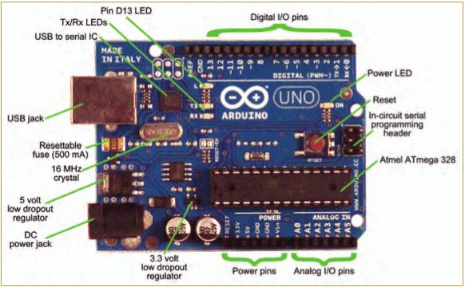
The Arduino Development Board
Making-robots-with-arduino.pdf

Slide 6
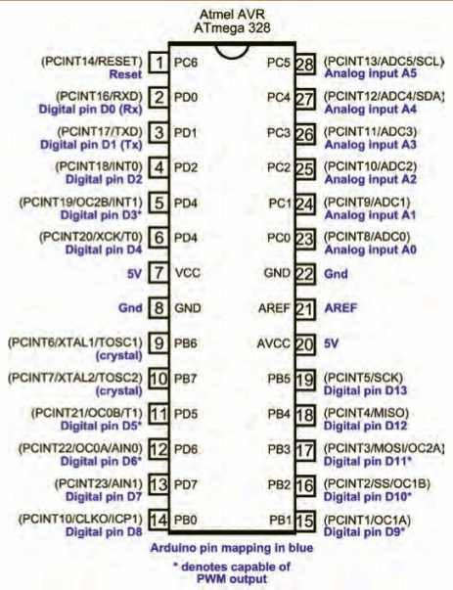

Slide 7
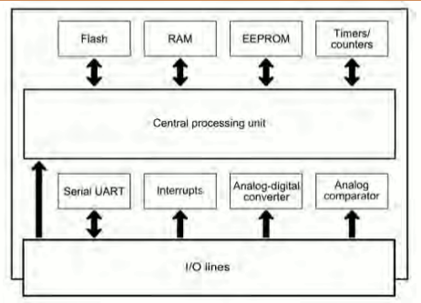
The Arduino Microcontroller: Atmel ARV Atmega 328

Slide 8
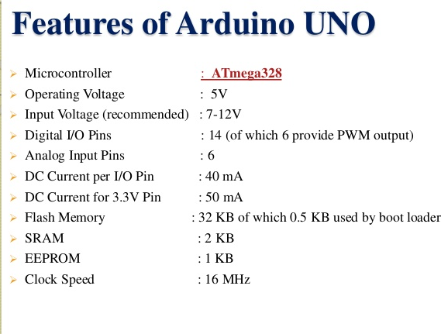

Slide 9
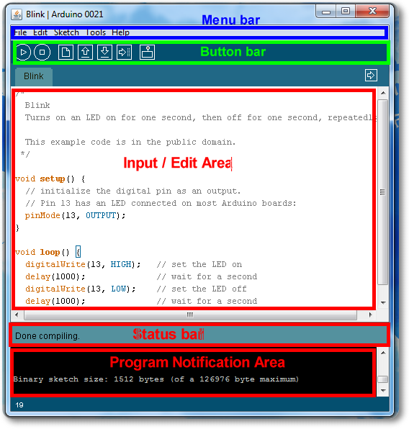
Arduino IDE
See: http://arduino.cc/en/Guide/Environment for more information

Slide 10
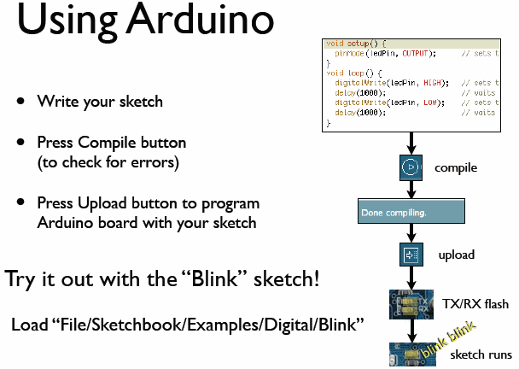
todbot.com/blog/bionicarduino

Slide 11
Structure of an Arduino Program
/* Blink - turns on an LED for DELAY_ON msec, then off for DELAY_OFF msec, and repeats
BJ Furman rev. 1.1 Last rev: 22JAN2011
*/
#define LED_PIN 13 // LED on digital pin 13
#define DELAY_ON 1000
#define DELAY_OFF 1000
void setup()
{
// initialize the digital pin as an output:
pinMode(LED_PIN, OUTPUT);
}
// loop() method runs forever,
// as long as the Arduino has power
void loop()
{
digitalWrite(LED_PIN, HIGH); // set the LED on
delay(DELAY_ON); // wait for DELAY_ON msec
digitalWrite(LED_PIN, LOW); // set the LED off
delay(DELAY_OFF); // wait for DELAY_OFF msec
}
An arduino program == ‘sketch’
  Must have:
    setup()
    loop()
  setup()
    configures pin modes and registers
  loop()
    runs the main body of the program forever
      like while(1) {…}
  Where is main() ?
    Arduino simplifies things
    Does things for you
Notes:
This slide is meant as a quick overview of an Arduino sketch. We’ll unpack and describe the pieces in more detail later.
Think of setup() as what you would do when you first get in a rental car or a car you have borrowed from a friend: adjust the mirrors, adjust the steering wheel, the seats, change the stereo channel settings, etc. The car can be driven by anyone, but everyone likes to customize it for their comfort.
main()
{
init();
setup();
while (1)
loop();
}
And the reason that they do it this way is so it's guaranteed that init() gets called, which is critical for Arduino initialization.

Slide 12
Example 1
Make Arduino pins 3, 5, and 7 (PD3, PD5, and PD7) to be outputs
Arduino approach
Alternate approach
pinMode(3, OUTPUT);
pinMode(5, OUTPUT);
pinMode(7, OUTPUT);
DDRD = 0b10101000;
or
DDRD = 0xA8;
or
Or if me106.h is used:
pinMode(PIN_D3, OUTPUT);
pinMode(PIN_D5, OUTPUT);
pinMode(PIN_D7, OUTPUT);
DDRD | = 1<<PD7 | 1<<PD5 | 1<<PD3;
More on this coming soon!

Slide 13
Reading/writing digital values
digitalWrite(13, LOW); // Makes the output voltage on pin 13 , 0V
digitalWrite(13, HIGH); // Makes the output voltage on pin 13 , 5V
int buttonState = digitalRead(2); // reads the value of pin 2 in buttonState

Slide 14
Reading/Writing Analog Values
analogRead(A0); // used to read the analog value from the pin A0
analogWrite(2,128);

Slide 15
Important functions
Serial.println(value);
  Prints the value to the Serial Monitor on your computer
pinMode(pin, mode);
  Configures a digital pin to read (input) or write (output) a digital value
digitalRead(pin);
  Reads a digital value (HIGH or LOW) on a pin set for input
digitalWrite(pin, value);
  Writes the digital value (HIGH or LOW) to a pin set for output

Slide 16
DELAY (2/3)
Arduino example:
delay(int milliseconds)
//creates a delay in ms
delayMicroseconds(int microseconds)
//creates a delay in μs
delay(1000); //one second delay
delayMicroseconds(10); //10 μs delay

Slide 17
Setting the Pin Data Direction
Microcontrollers are fundamentally digital devices. For digital IO pins:
  Information is ‘coded’ in two discrete states:
    HIGH or LOW (logic: 1 or 0)
    Voltages
      TTL
        5 V (for HIGH)
        0 V (for LOW)
      3.3 V CMOS
        3.3 V (for HIGH)
        0 V (for LOW)
Arduino
  pinMode(pin_no., dir)
    Ex. Make Arduino pin 3 (PD3) an output
      pinMode(3, OUTPUT);
      pinMode(PIN_D3, OUTPUT); // with me106.

Slide 18
Port Pin Data Directionality
Input
  When you want to take information from the external world (sensors) into the MCU
Output
  When you want to change the state of something outside the MCU (turn a motor on or off, etc.)
Pins default to input direction on power-up or reset
Your program can set or change the directionality of a pin at any time
Notes:
This is really important!

Slide 19
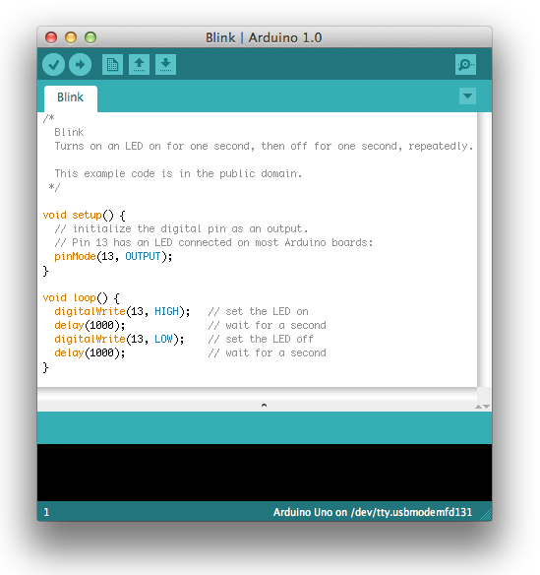
Our First Program

Slide 20
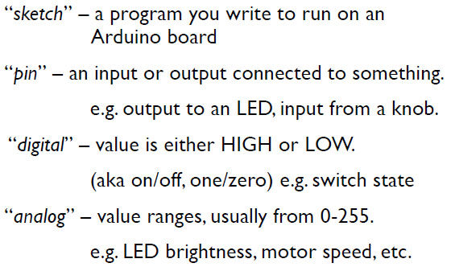
Terminology

Slide 21
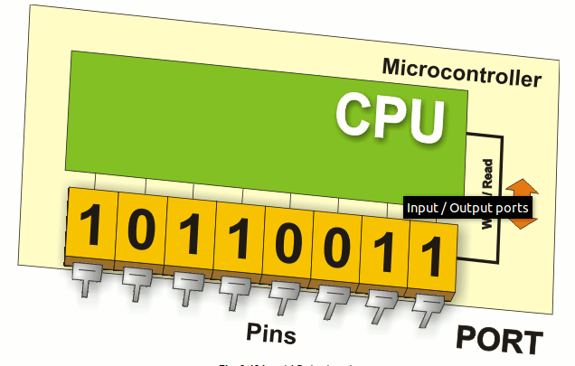
Digital I/0
pinMode(pin, mode)
  Sets pin to either INPUT or OUTPUT
digitalRead(pin)
  Reads HIGH or LOW from a pin
digitalWrite(pin, value)
  Writes HIGH or LOW to a pin
Electronic stuff
  Output pins can provide 40 mA of current
  Writing HIGH to an input pin installs a 20KΩ pullup

Slide 22
Arduino Timing
delay(ms)
  Pauses for a few milliseconds
delayMicroseconds(us)
  Pauses for a few microseconds
More commands: arduino.cc/en/Reference/HomePage

Slide 23

Digital IO – Practice 2 (Arduino style code)
#define PIN_IGNITION 0
#define PIN_SEATBELT 1
#define PIN_LED 2
#define PIN_BUZZER 3
#define SEATBELT_LATCHED LOW
#define KEY_IN_IGNITION LOW
#define LED_ON HIGH
#define LED_OFF LOW
#define BUZZER_ON HIGH
#define BUZZER_OFF LOW
void setup()
{
pinMode(PIN_IGNITION, INPUT_PULLUP); // key switch
pinMode(PIN_SEATBELT, INPUT_PULLUP); // belt latch switch
pinMode(PIN_LED, OUTPUT); // lamp
pinMode(PIN_BUZZER, OUTPUT); // buzzer
}
void loop()
{ /* see next page for code */}
ATmega328
PD3
PD2
V_{TG}= +5V
1
PD0, PD1
0
Notes:
Arduino style
Note #define for state of switches – an Abstraction. Deals with the condition as a concept rather than just a number.

Slide 24
Digital IO – Practice 2 (Arduino style code)
/* see previous page for code before loop() */
void loop()
{
int key_state = digitalRead(PIN_IGNITION);
int belt_state = digitalRead(PIN_SEATBELT);
if (key_state == KEY_IN_IGNITION)
{
if (belt_state == SEATBELT_LATCHED)
{
digitalWrite(PIN_BUZZER, BUZZER_OFF);
digitalWrite(PIN_LED, LED_OFF);
}
else // key is in ignition, but seatbelt NOT latched
{
digitalWrite(PIN_BUZZER, BUZZER_ON);
digitalWrite(PIN_LED, LED_ON);
}
else // key is NOT in ignition
{
digitalWrite(PIN_BUZZER, BUZZER_OFF);
digitalWrite(PIN_LED, LED_OFF);
}
}
}
ATmega328
PD3
PD2
V_{TG}= +5V
1
PD0, PD1
0
Notes:
Arduino style
Note #define for state of switches – an Abstraction. Deals with the condition as a concept rather than just a number.

Slide 25
Fading of LED

Slide 26
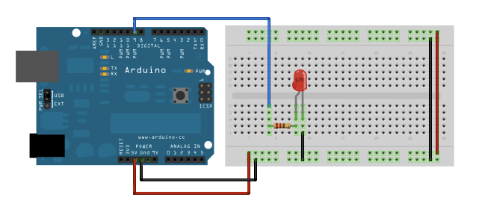

Slide 27
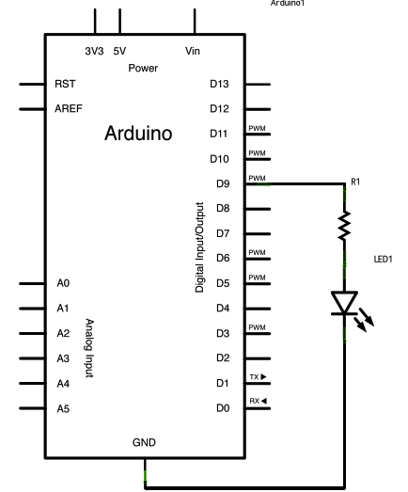

Slide 28
int led = 9; // the PWM pin the LED is attached to
int brightness = 0; // how bright the LED is
int fadeAmount = 5; // how many points to fade the LED by
// the setup routine runs once when you press reset:
void setup() {
// declare pin 9 to be an output:
pinMode(led, OUTPUT);
}
// the loop routine runs over and over again forever:
void loop() {
// set the brightness of pin 9:
analogWrite(led, brightness);
// change the brightness for next time through the loop:
brightness = brightness + fadeAmount;
// reverse the direction of the fading at the ends of the fade:
if (brightness <= 0 || brightness >= 255) {
fadeAmount = -fadeAmount;
}
// wait for 30 milliseconds to see the dimming effect
delay(30);
}

Slide 29
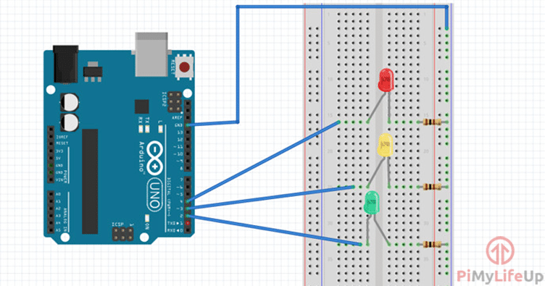
Traffic Light

Slide 30
Simple traffic Light Program
// variables
int GREEN = 2; int YELLOW = 3;
int RED = 4;
int DELAY_GREEN = 5000;
int DELAY_YELLOW = 2000;
int DELAY_RED = 5000;

Slide 31
// basic functions
void setup()
{
pinMode(GREEN, OUTPUT);
pinMode(YELLOW, OUTPUT);
pinMode(RED, OUTPUT);
}
void loop()
{
green_light();
delay(DELAY_GREEN);
yellow_light();
delay(DELAY_YELLOW);
red_light(); delay(DELAY_RED);
}

Slide 32
void green_light()
{
digitalWrite(GREEN, HIGH);
digitalWrite(YELLOW, LOW);
digitalWrite(RED, LOW);
}
void yellow_light()
{
digitalWrite(GREEN, LOW); digitalWrite(YELLOW, HIGH);
digitalWrite(RED, LOW);
}
void red_light()
{
digitalWrite(GREEN, LOW);
digitalWrite(YELLOW, LOW); digitalWrite(RED, HIGH);
}

Slide 33
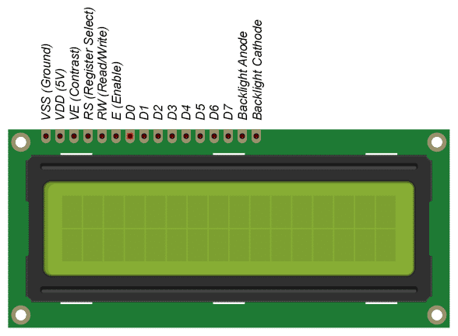
LCD Display

Slide 34
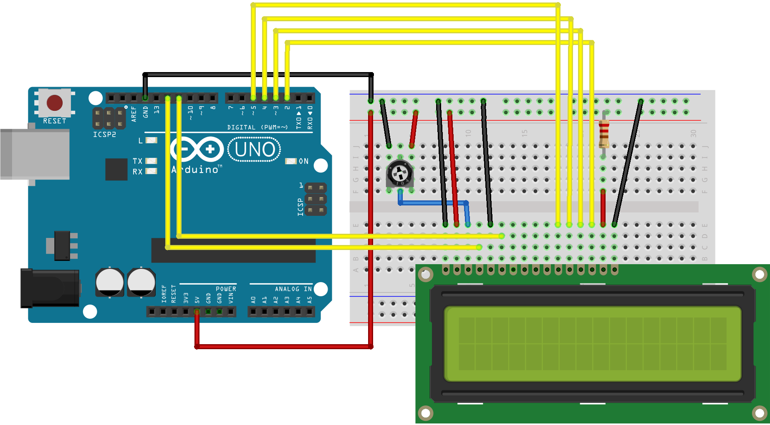

Slide 35
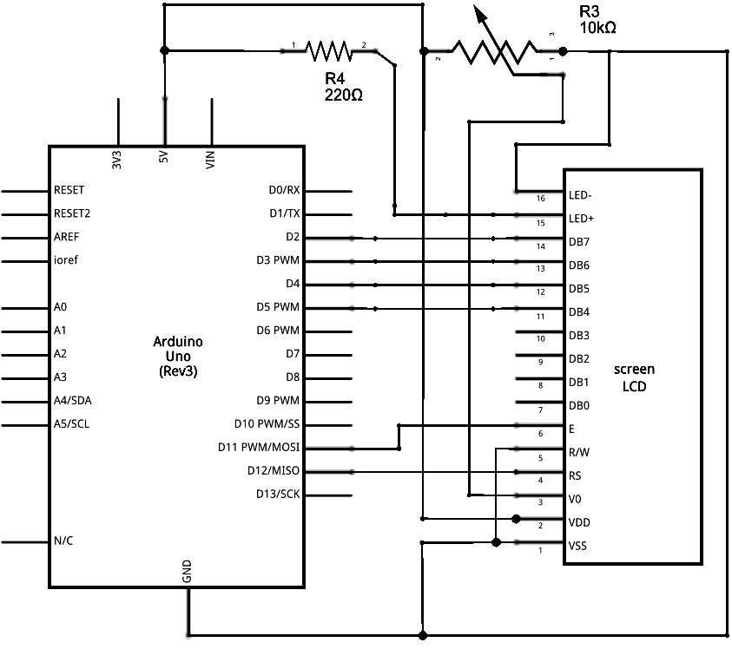

Slide 36
LCD library code
Create a new LiquidCrystal object:
When a new object is created, the data passed to the constructor is stored in the object. Thus, whenever we use the variable lcd again in the program, the lcd object “knows” that it is connected to p1, p2, ..., p6.
LiquidCrystal lcd(p1,p2,p3,p4,p5,p6);
Type of object
Name of the new object
Data passed to the object constructor

Slide 37
#include <LiquidCrystal.h>
LiquidCrystal lcd(12, 11, 5, 4, 3, 2);
void setup()
{
lcd.begin(16, 2);
lcd.print("hello, world!");
}
void loop()
{
lcd.setCursor(0, 1);
lcd.print(millis() / 1000);
}
Parameters: (rs, enable, d4, d5, d6, d7)

Slide 38
void loop() {
lcd.print("Arduino"); // Prints "Arduino" on the LCD
delay(3000); // 3 seconds delay
lcd.setCursor(2,1); // Sets the location at which subsequent text written to the LCD will be displayed
lcd.print("LCD Tutorial");
delay(3000);
lcd.clear(); // Clears the display
lcd.blink(); //Displays the blinking LCD cursor
delay(4000);
lcd.setCursor(7,1);
delay(3000);
lcd.noBlink(); // Turns off the blinking LCD cursor
lcd.cursor(); // Displays an underscore (line) at the position to which the next character will be written
delay(4000);
lcd.noCursor(); // Hides the LCD cursor
lcd.clear(); // Clears the LCD screen
}
#include <LiquidCrystal.h>
LiquidCrystal lcd(1, 2, 4, 5, 6, 7);
// Creates an LC object. Parameters: (rs, enable, d4, d5, d6, d7) //
void setup()
{
lcd.begin(16,2);
}
// Initializes the interface to the LCD screen, and specifies the dimensions (width and height) of the display

Slide 39
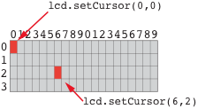
Character matrix on a 4 X 20 display
Row and column indices begin with zero

Slide 40
7 Segment Display

Slide 41
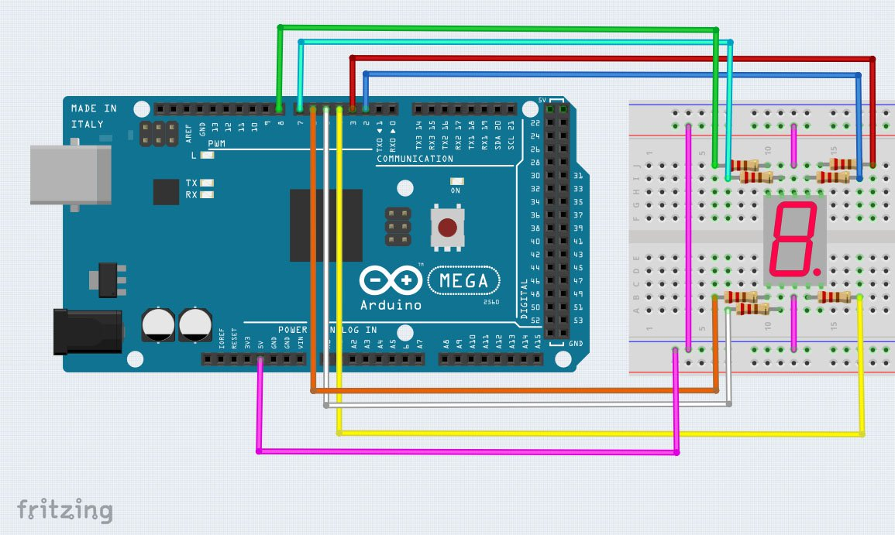

Slide 42
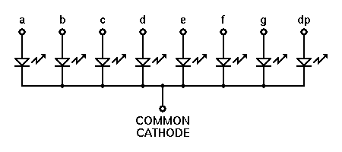
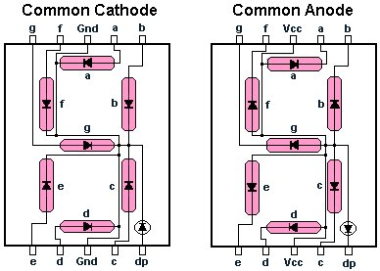
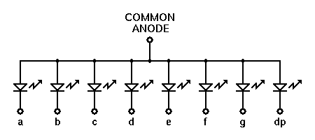

Slide 43
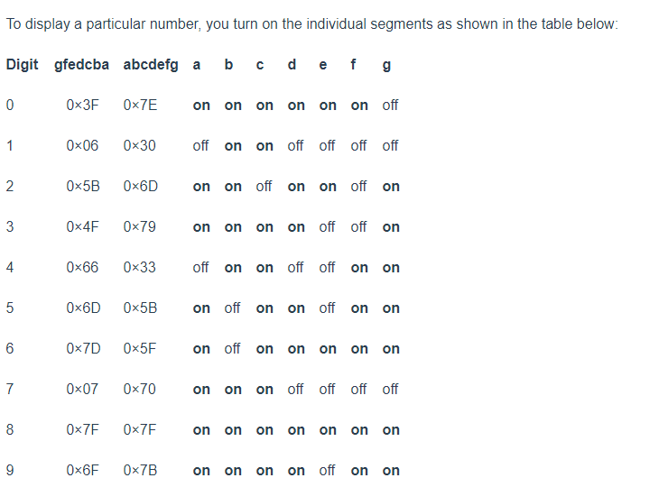

Slide 44
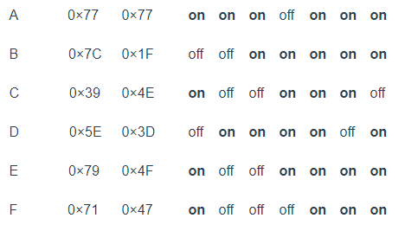

Slide 45
void setup()
{
pinMode(2,OUTPUT); pinMode(3,OUTPUT); pinMode(4,OUTPUT); pinMode(5,OUTPUT); pinMode(6,OUTPUT); pinMode(7,OUTPUT); pinMode(8,OUTPUT);
}
void loop()
{
for(int i=2;i<9;i++)
{
digitalWrite(i,HIGH);
delay(600);
}
for(int i=2;i<9;i++)
{
digitalWrite(i,LOW);
delay(600);
} delay(1000);
}

Slide 46
INTERNET OF THINGS WITH ARDUINO

Slide 47
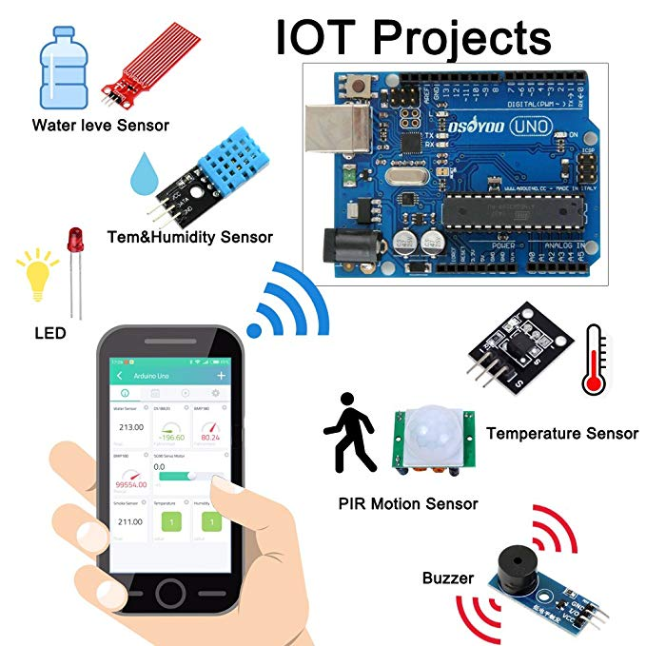

Slide 48
